Slide 1



DATA STRUCTURES AND ITS APPLICATIONS
Graphs
Saritha
Department of Computer Science & Engineering

Slide 2


DATA STRUCTURES AND ITS APPLICATIONS
Representation of Network Topology
Saritha
Department of Computer Science & Engineering

Slide 3
DATA STRUCTURES AND ITS APPLICATIONS
Applications: Network Topology
Graph data structure is mainly in Computer Networks, Telecommunication, Electronic Circuits and Transport Networks.
Networking uses the Notation G(N,L) instead of G(V,E) for a graph where N is the set of nodes and L is the set of links.

Slide 4
DATA STRUCTURES AND ITS APPLICATIONS
Applications: Network Topology
Topology is the order in which nodes and edges are arranged in the network.
How the computers are connected or related to one another in a computer.
There are 2 types of Topology
1. Physical
2. Logical

Slide 5
DATA STRUCTURES AND ITS APPLICATIONS
Applications: Network Topology
1.Ring Topology
2.Star Topology
3.Mesh Topology
4.BusTopology

Slide 6
1.Adjacency Matrix
DATA STRUCTURES AND ITS APPLICATIONS
Representation of Graph
2.Adjacency List

Slide 7
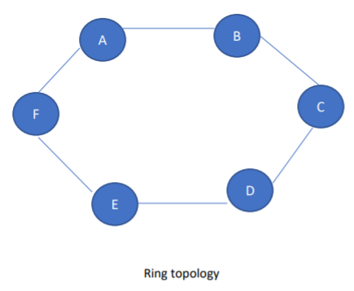
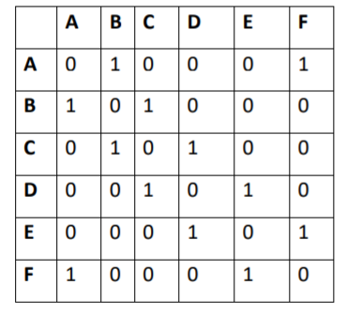
1. Ring topology (cycle): A cycle graph is a simple graph which has two degrees of vertices.
DATA STRUCTURES AND ITS APPLICATIONS
Applications: Network Topology

Slide 8
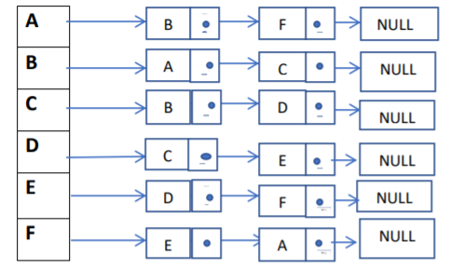
DATA STRUCTURES AND ITS APPLICATIONS
Applications: Network Topology

Slide 9
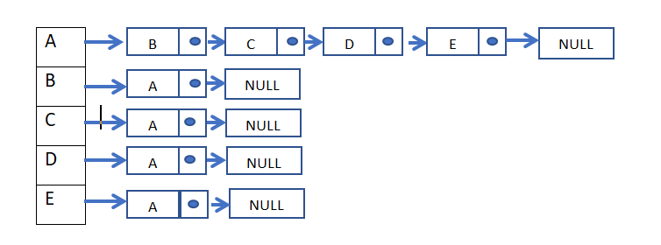
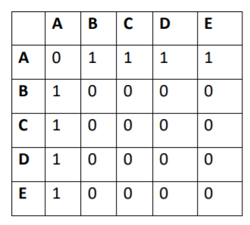
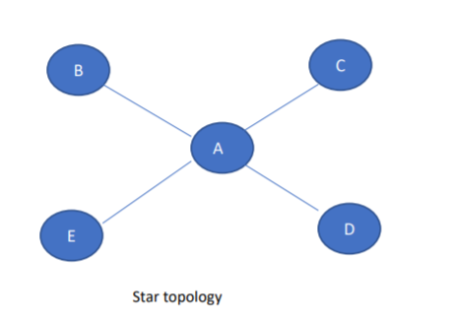
2.Star topology: Star topology is a network topology in the form of merging from the central vertex to each vertex .
DATA STRUCTURES AND ITS APPLICATIONS
Applications: Network Topology

Slide 10
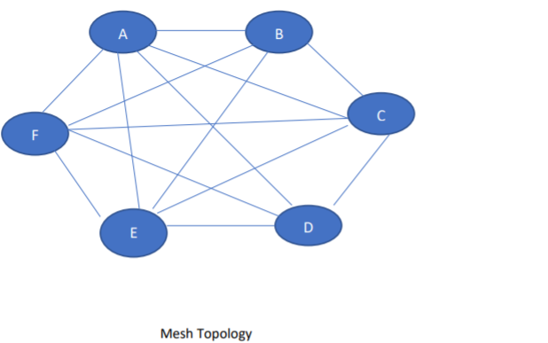
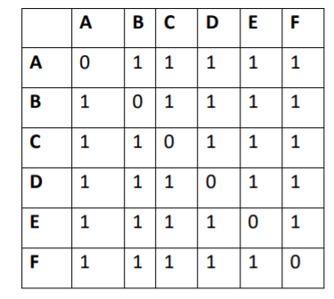
3.Mesh topology: Mesh Topology is a complete graph in which all the vertex is connected to all other vertices
DATA STRUCTURES AND ITS APPLICATIONS
Applications: Network Topology

Slide 11
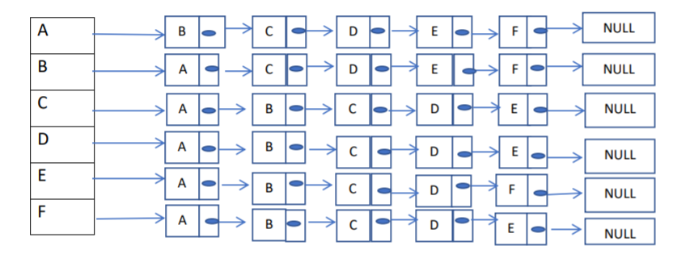
DATA STRUCTURES AND ITS APPLICATIONS
Applications: Network Topology

Slide 12
DATA STRUCTURES AND ITS APPLICATIONS
Bus Topology
A Graph G with V vertices is said to represent a bus topology if
1.Every node except the starting and ending node has degree 2 and starting and ending node have degree 1.
2. Number of edges=Number of vertices -1
 | A | B | C | D
A | 0 | 1 | 0 | 0
B | 1 | 0 | 1 | 0
C | 0 | 1 | 0 | 1
D | 0 | 0 | 1 | 0
A
B
C
D

Slide 13
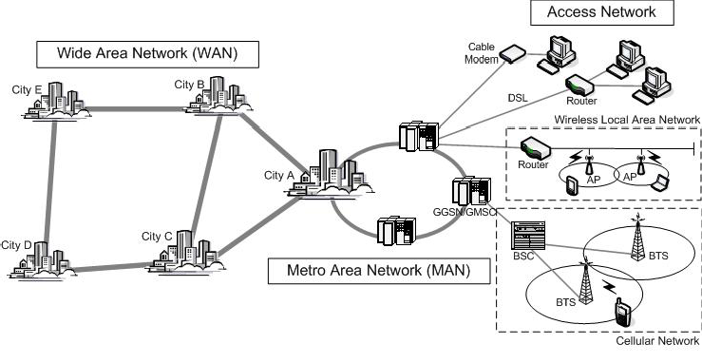
Most networks a mix of rings, mesh – depending on network type, cost/traffic/reliability
DATA STRUCTURES AND ITS APPLICATIONS
Applications: Network Topology
Picture Courtesy: ComputerNetworkTopology.com

Slide 14

THANK YOU
Saritha
Department of Computer Science & Engineering
Saritha.k@pes.edu
9844668963

